Slide 1
Real/Fake Job Posting Prediction
Xiaohan Liu
@ OneCareer
Oct-27-2024

Slide 2
Roadmap
Data Preprocessing and EDA
Modeling
Inference and Discussion

Slide 3
Data Preprocessing and EDA

Slide 4
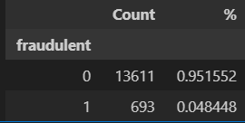
Data Import and Label
Data Preprocessing and EDA 1/11
This binary classification project has 2 challenges, 16 heterogenous features and 17,880 imbalanced target.
3 NA-free binary/Boolean features, [telecommuting], [has_company_logo], [has_questions].
7 multinomial categorical features affected by missing values, [salary_range], [department], [required_education], [required_experience], [function], [industry], [employment_type].
6 textual features, [benefits], [company_profile], [requirements], [description], [location], 5 contain missing values.
Insight: A 19:1 class ratio begs for including ROC-AUC as the primary evaluation metric and using class weights during modeling.

Slide 5
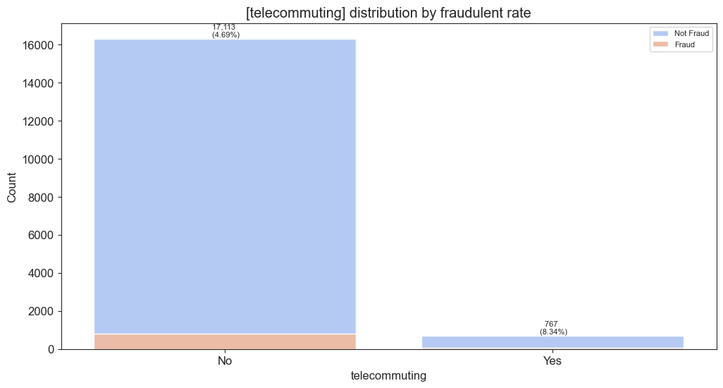
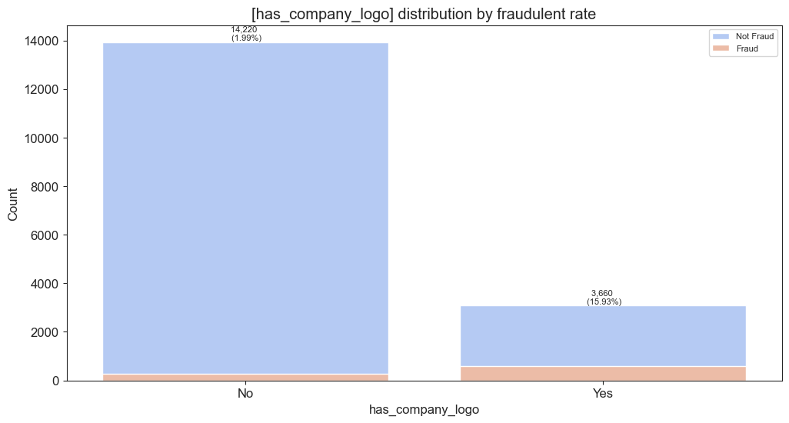
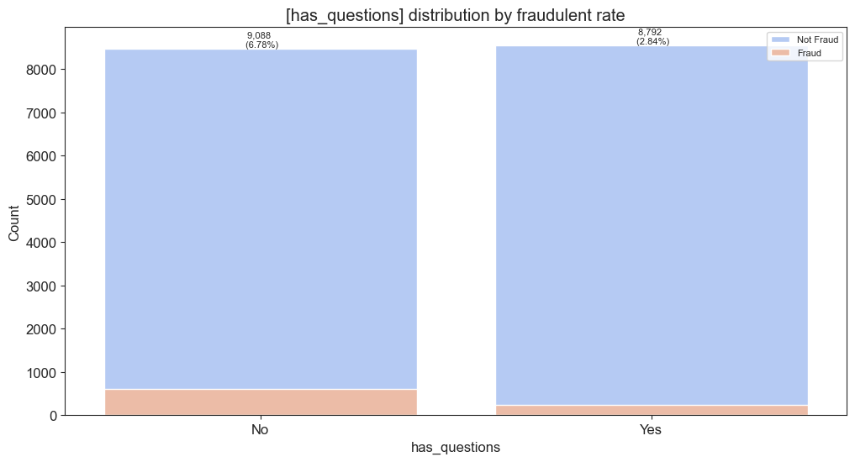
Binary features (no NAs)
Data Preprocessing and EDA 2/11
The
Insight:
[has_company_logo] looks promising

Slide 6
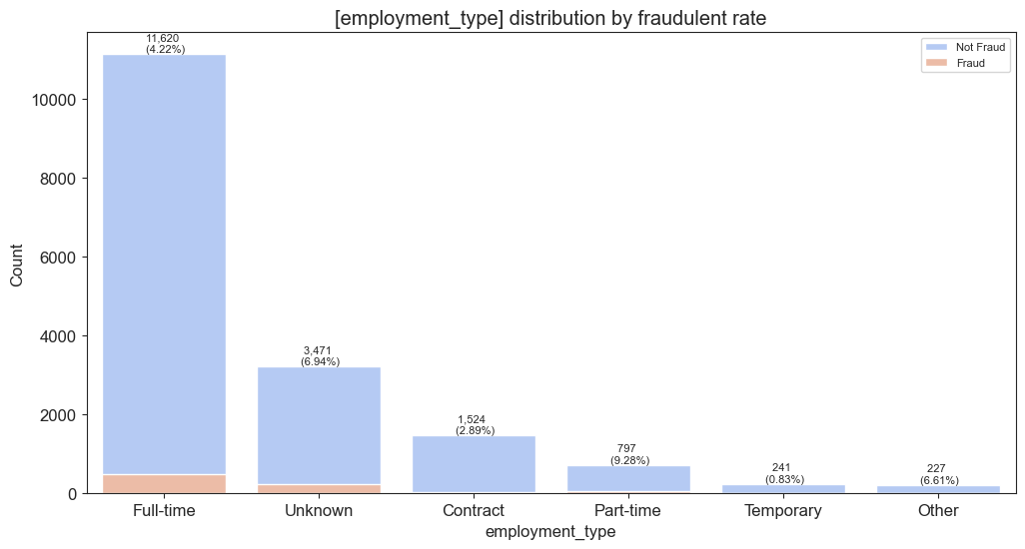
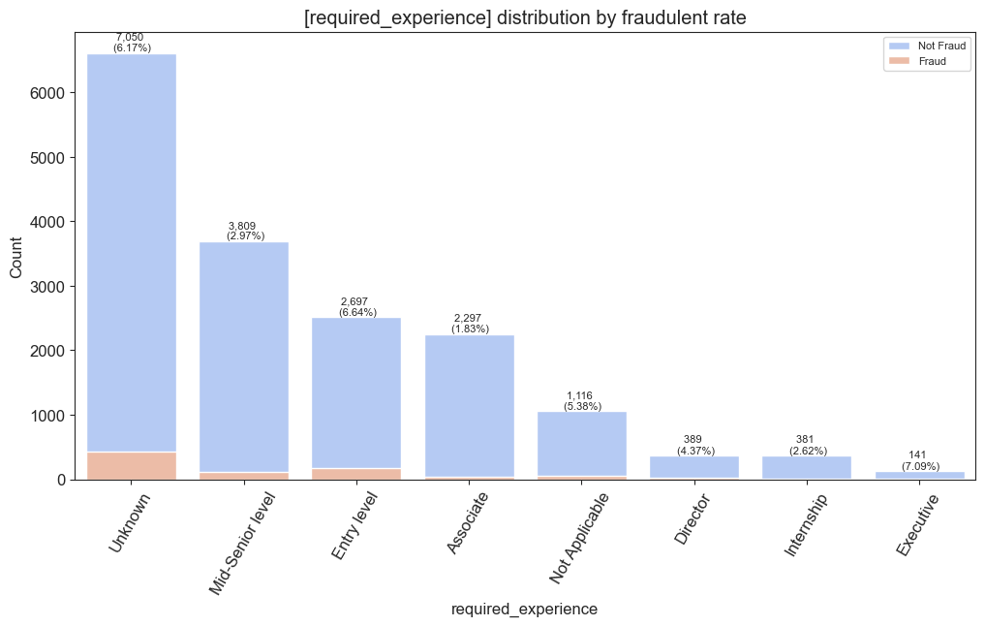
Categorical Features 1-2
Data Preprocessing and EDA 3/11
- 19% missing.
- Its cardinality is 6.
- Compared to the population 4.85% fraudulent rate, the following are significantly higher:
- Unknown(6.94%)
- Part-time(9.28%) The following are significantly lower:
- Temporary(0.83%)
- Contract(2.89%)
- 39% missing.
- Its cardinality is 8.
- Compared to the population 4.85% fraudulent rate, the following are significantly higher:
- Executive(7.09%)
The following are significantly lower:
- Associate Level(1.83%)
- Internship(2.79%)

Slide 7
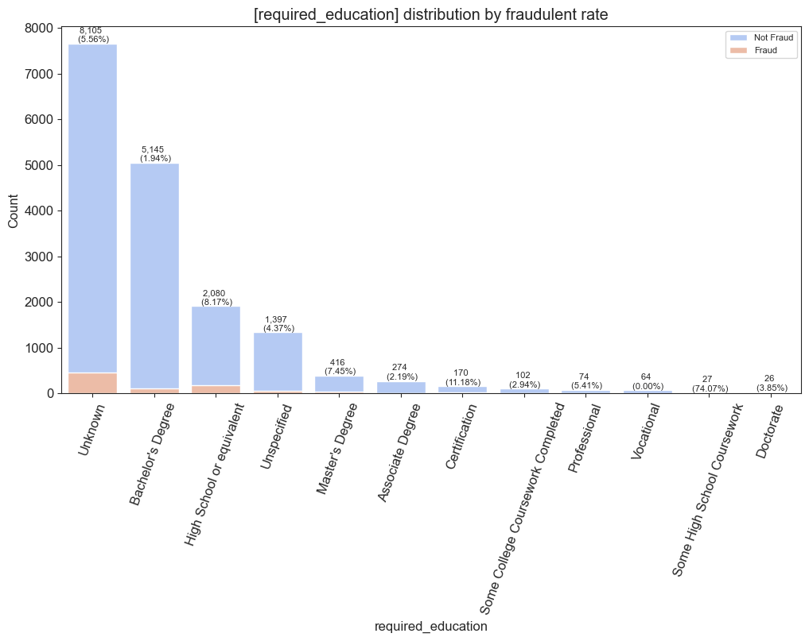
Categorical Features 3
Data Preprocessing and EDA 4/11
- 45% missing.
- Its cardinality is 14 before the pre-processing.
- Its cardinality is 12 after the pre-processing.
- Compared to the population 4.85% fraudulent rate, the following are significantly higher:
- Some High School Coursework(74.07%)
- High School or Equivalent(8.17%)
- Certification(11.18%)
The following are significantly lower:
- Bachelor's Degree(1.94%)
- Associate Degree(2.19%)
- _**Vocational(0%)**_

Slide 8
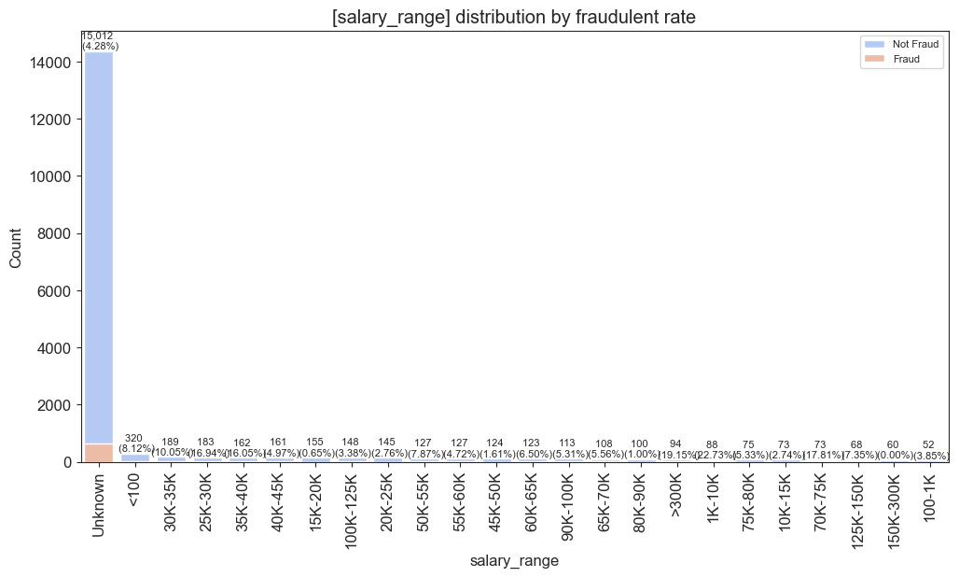
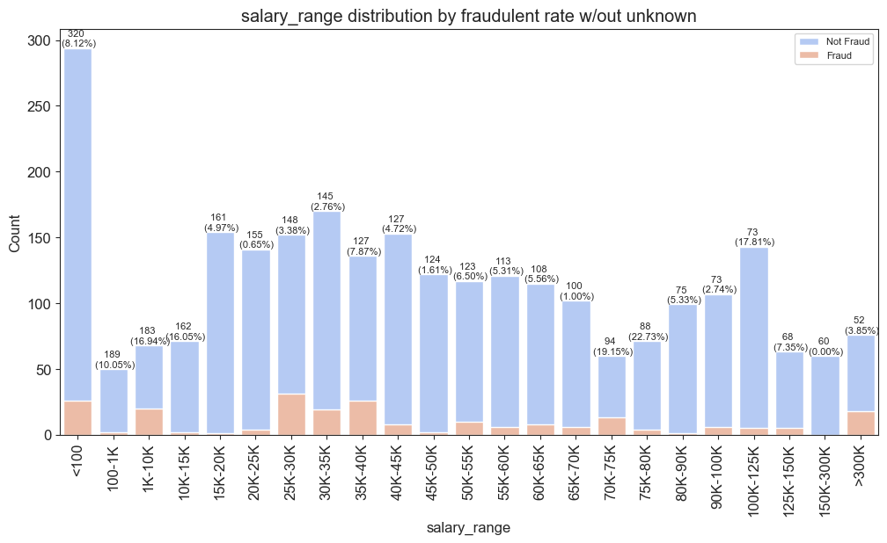
Categorical Features 4
Data Preprocessing and EDA 5/11
- 84% Missing.
- Its cardinality is 875 before the preprocessing
- Its cardinality is 22 after the preprocessing.
- Compared to the population 4.85% fraudulent rate, the following are significantly higher:
- 100-1K (10.05%)
- 1K-10K (16.94%)
- 10K-15K (16.05%)
- 35K-40K (7.87%)
- 70K-75K (19.15%)
- 75K-80K (22.73%)
- 100K-125K (17.81%)
- 125K-150K (7.35%)
The following are significantly lower:
- 20K-25K (0.65%)
- 30K-35K (2.76%)
- 45K-50K (1.61%)
- 65K-70K (1.00%)
- 90K-100K (2.74%)
- 150K-300K (0%)

Slide 9
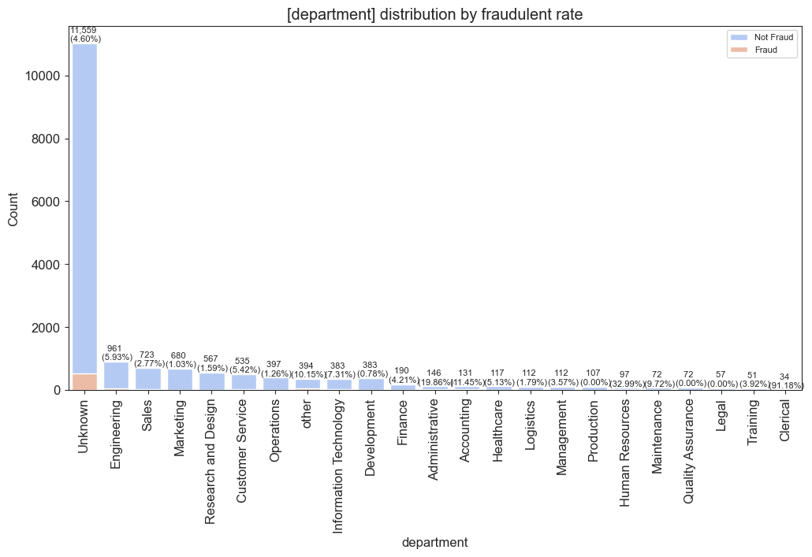
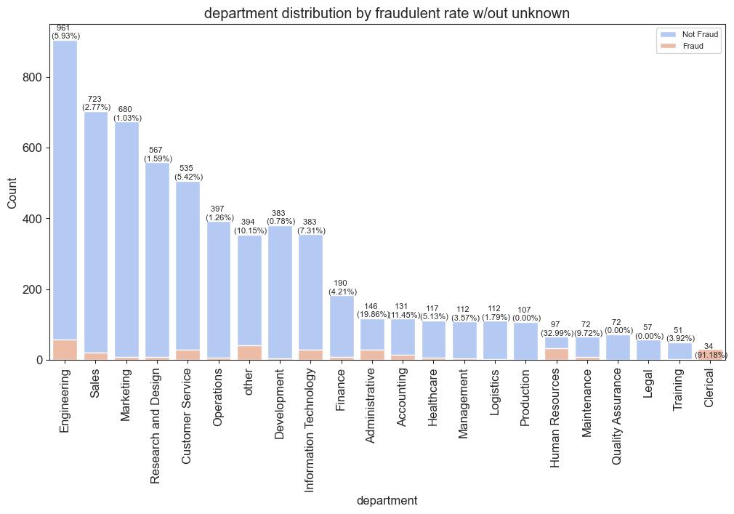
Categorical Features 5
Data Preprocessing and EDA 6/11
- 65% Missing.
- Its cardinality is 1337 before the preprocessing.
- Its cardinality is 22 after the preprocessing.
- Compared to the population 4.85% fraudulent rate, the following are significantly higher:
- Other(10.15%)
- Administrative(19.86%)
- Accounting(11.45%)
- Human Resources(32.99%)
- Maintenance(9.72%)
- Clerical(91.18%)
The following are significantly lower:
- Information Technology(1.83%)
- Sales(2.77%)
- Marketing(1.03%)
- Management(2.61%)
- Research and Design(1.59%)
- Operations(1.26%)
- Development(0.78%)
- Logistics(1.79%)
- Consulting and Strategy(2.63%)
- General Business(1.20%)
- Public Relations(1.32%)
- _**Production(0%)**_
- _**Quality Assurance(0%)**_
- _**Legal(0%)**_

Slide 10
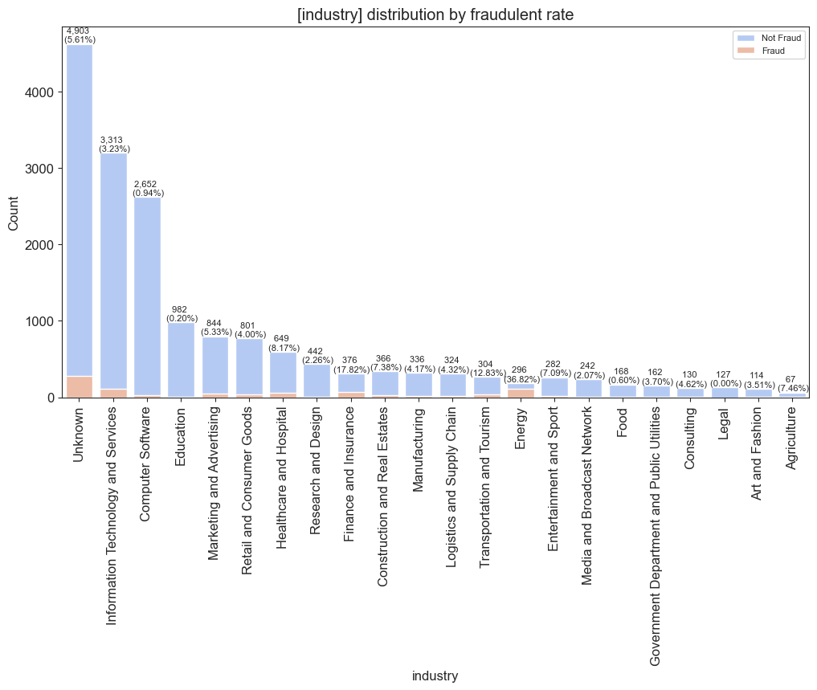
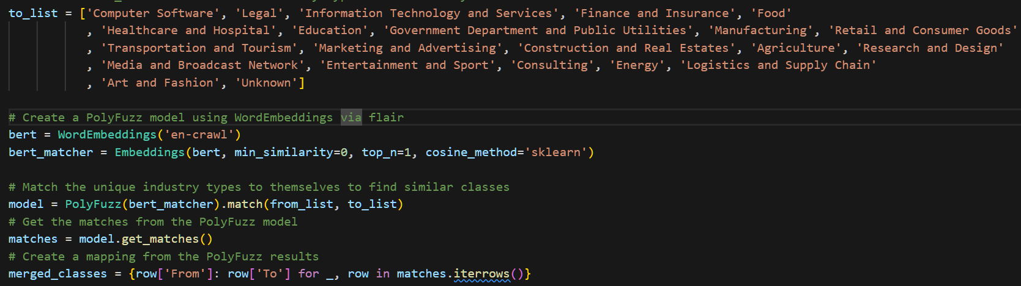
Categorical Features 6
Data Preprocessing and EDA 7/11
- 27% missing.
- Its cardinality is 132 before the preprocessing.
- Its cardinality is 22 after the preprocessing.
- Compared to the population 4.85% fraudulent rate, the following are significantly higher:
- Healthcare and Hospital(8.17%)
- Finance and Insurance(17.82%)
- Transportation and Tourism(12.83%)
- Energy(36.82%)
The following are significantly lower:
- Computer Software(0.94%)
- Education(0.20%)
- Research and Design(2.26%)
- Media and Networks(2.07%)
- Food(0.60%)
- _**Legal(0%)**_

Slide 11
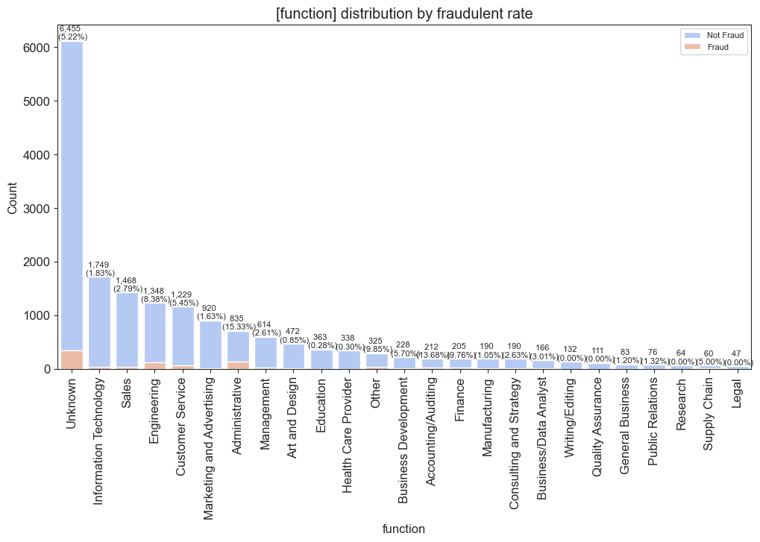
Categorical Features 7
Data Preprocessing and EDA 8/11
- 36% missing.
- Same preprocessing as Categorical 6.
- Its cardinality is 38 before the preprocessing.
- Its cardinality is 25 after the preprocessing.
- Compared to the population 4.85% fraudulent rate, the following are significantly higher:
- Engineering(8.38%)
- Administrative(15.33%)
- Accounting/Auditing(13.68%)
- Finance(9.76%)
- Other(9.85%)
The following are significantly lower:
- Information Technology(1.83%)
- Sales(2.79%)
- Marketing and Advertising(1.63%)
- Management(2.61%)
- Art and Design(0.85%)
- Education(0.28%)
- Healthcare Provider(0.30%)
- Manufacturing(1.05%)
- Consulting and Strategy(2.63%)
- General Business(1.20%)
- Public Relations(1.32%)
- _**Writing/Editing(0%)**_
- _**Quality Assurance(0%)**_
- _**Research(0%)**_
- _**Legal(0%)**_

Slide 12
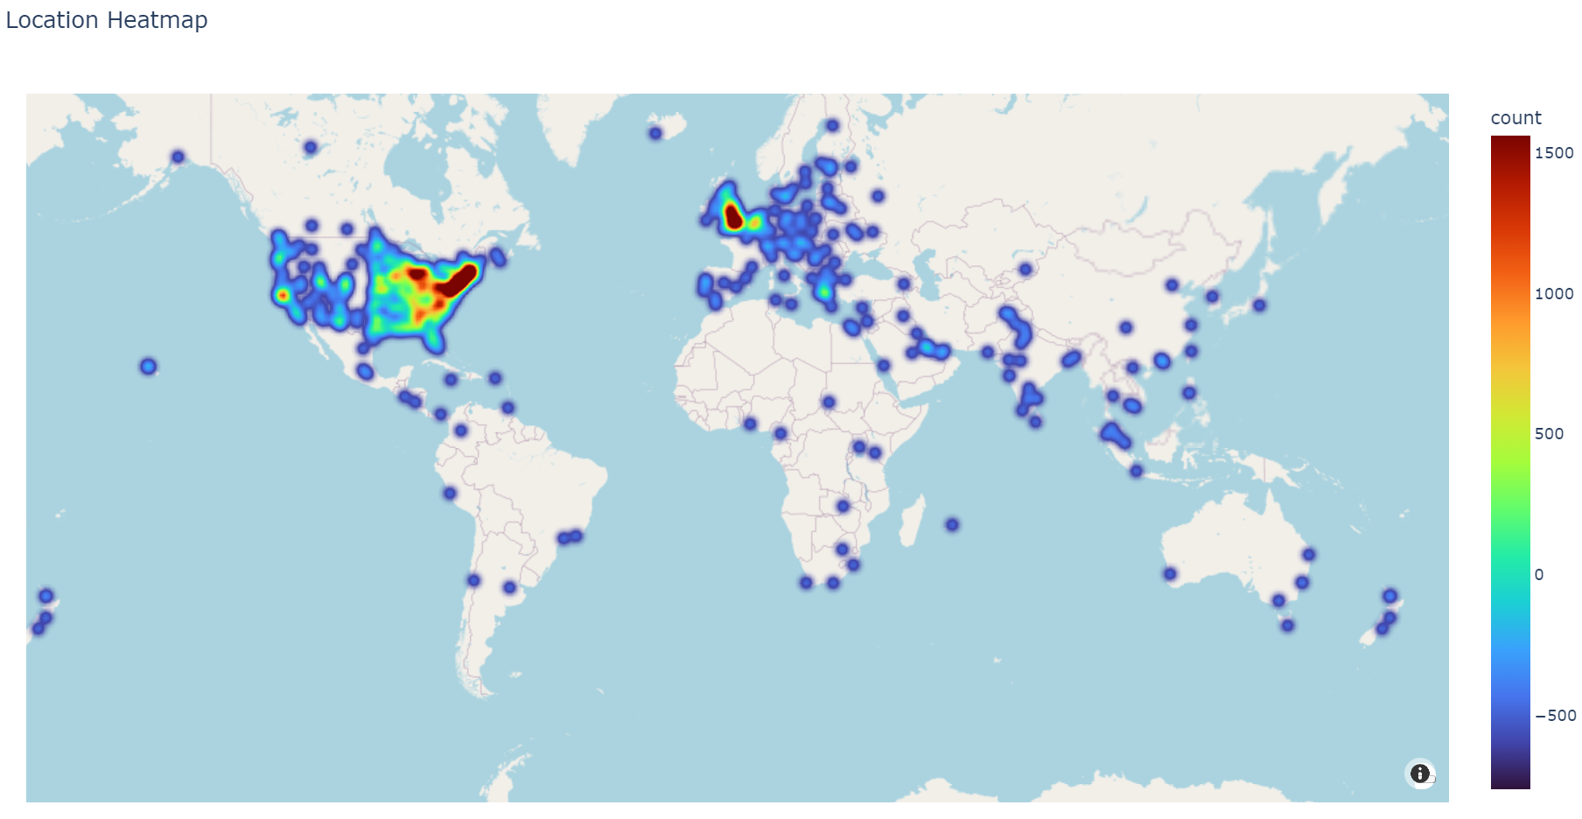
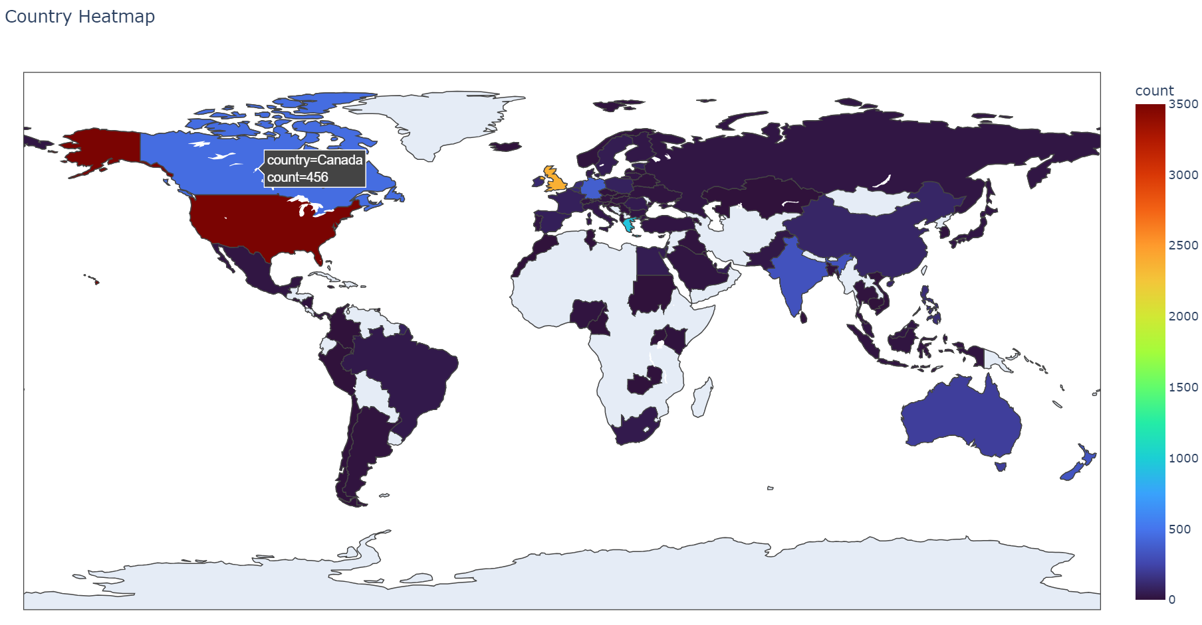
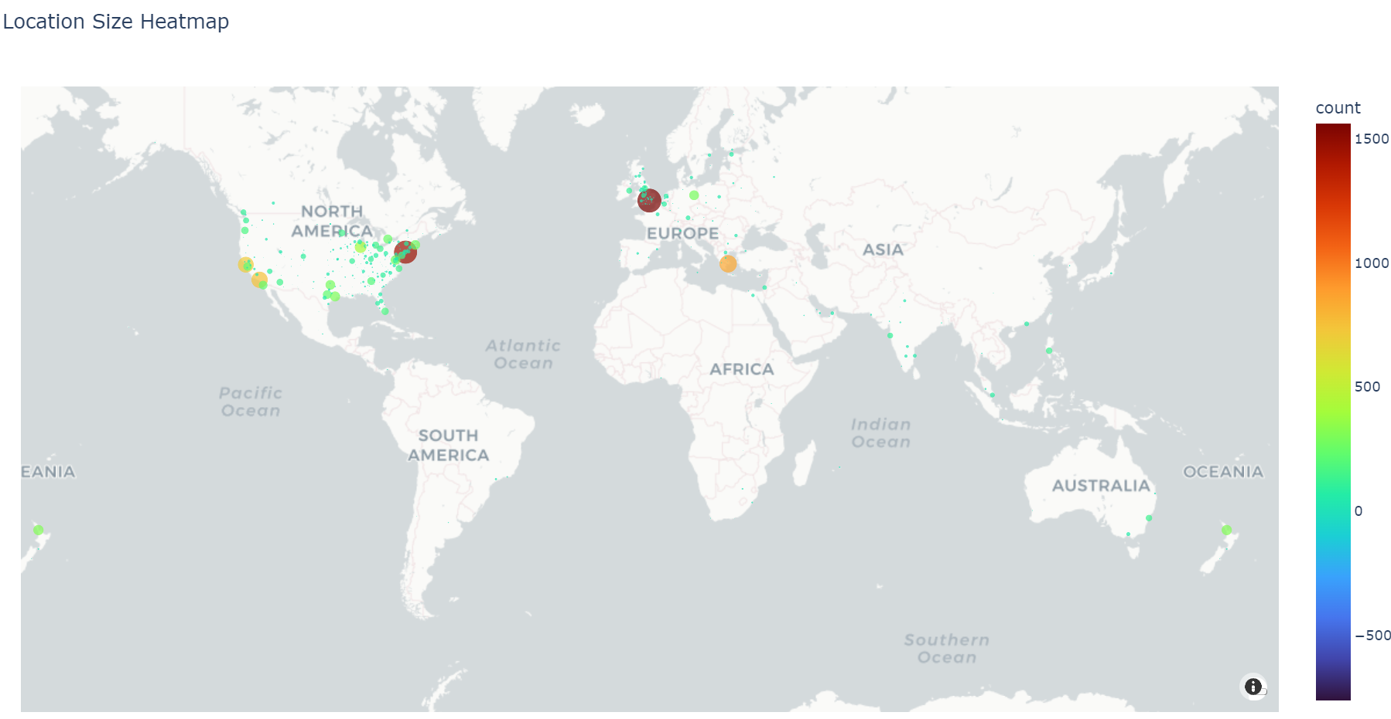
Categorical 7.5 + Textual 0.5
Data Preprocessing and EDA 9/11
- 2% missing
- we can see that the Format of the Data present is : **Country Name(Abbreviated) , State Name(Abbreviated) , City Name / Area Name.** We just extract the country into a new categorical column [Country] with cardinality of 87.
- The standardized [location] column will be considered as a member of the textual packs and treated along with the rest of the pack.

Slide 13
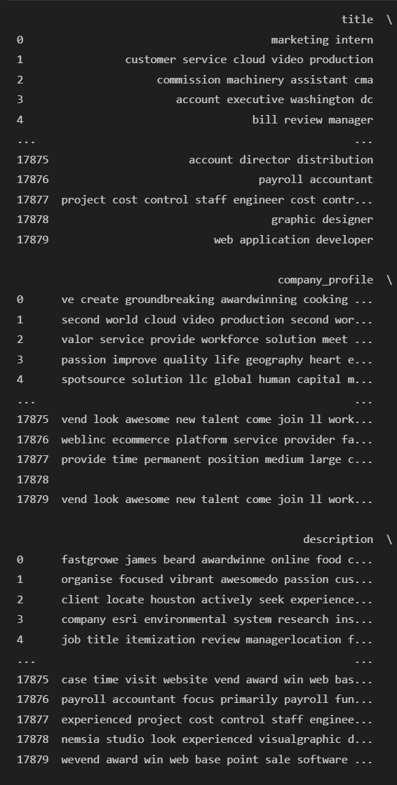
6 Textual Features
Data Preprocessing and EDA 10/11
Do NOT merge textual features.
Impute the missing values by empty strings.
Lowercasing.
Remove URLs.
Remove HTML tags.
Remove punctuations,
Tokenization
Using SpaCy’s ‘en_core_web_lg’ pretrained model to remove stop words, add POS tags, and lemmatize

Slide 14
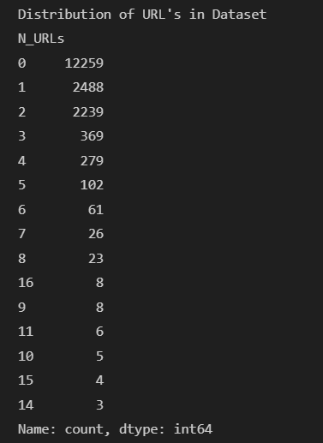
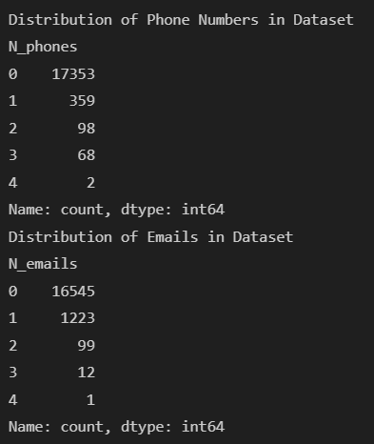
Numeric Features
Data Preprocessing and EDA 11/11
- Create columns to count the occurrence of URLs, Emails and Phone Numbers in [text] row-wise [N_URLs], [N_phones] , [N_emails] as numeric features.
- Create another numeric feature to record the length of the text as [len_text]

Slide 15
Modeling (CatBoost)

Slide 16
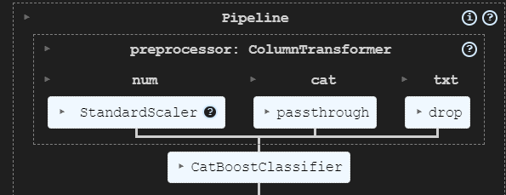
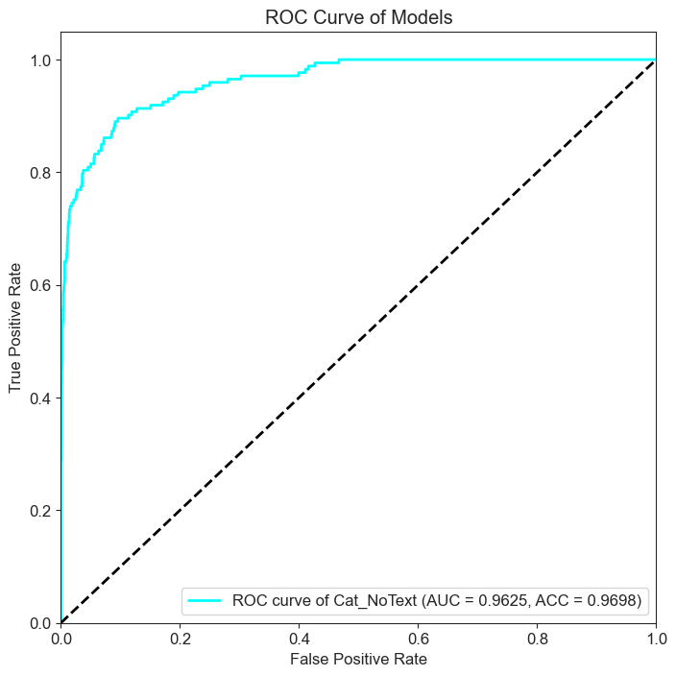
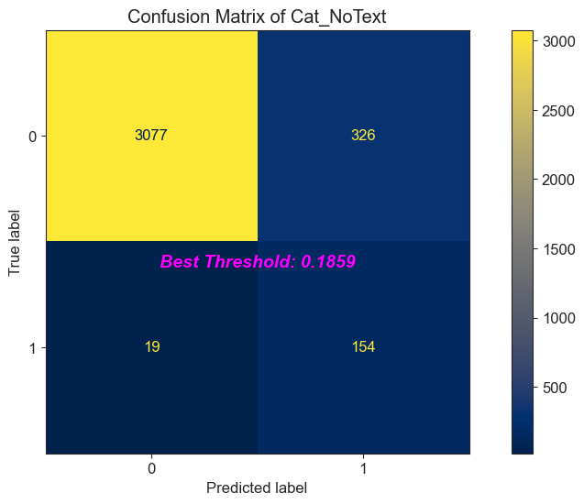
Tabular Only
Modeling 1/5

Slide 17
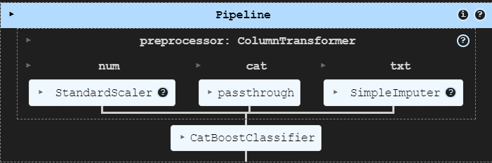
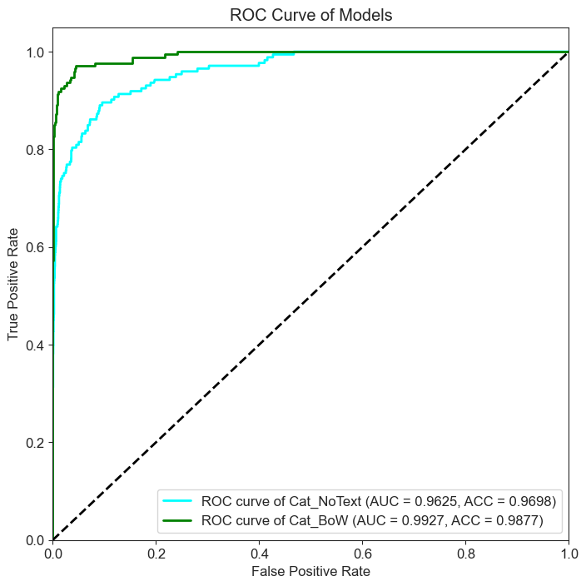
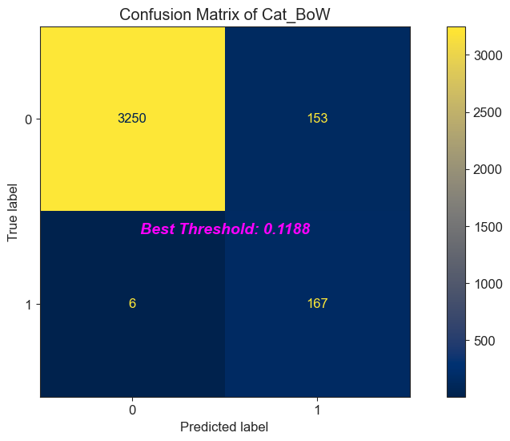
Tabular + BoW(Bag-of-Word)
Modeling 2/5

Slide 18
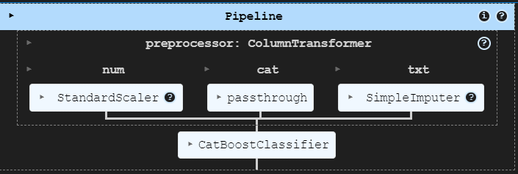
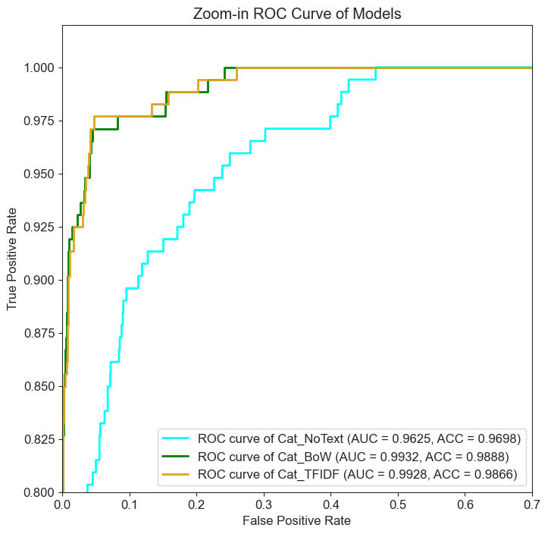

Tabular + TF-IDF
Modeling 3/5

Slide 19
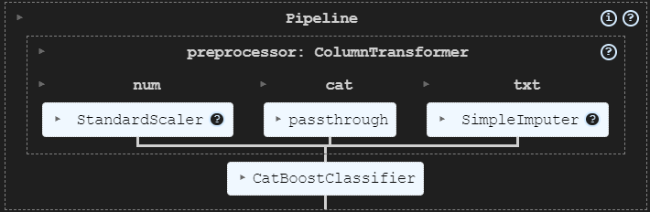
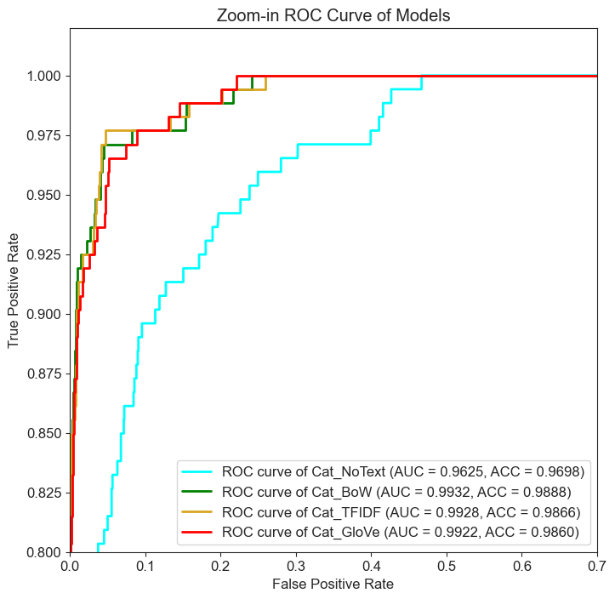

Tabular + GloVe
Modeling 4/5

Slide 20
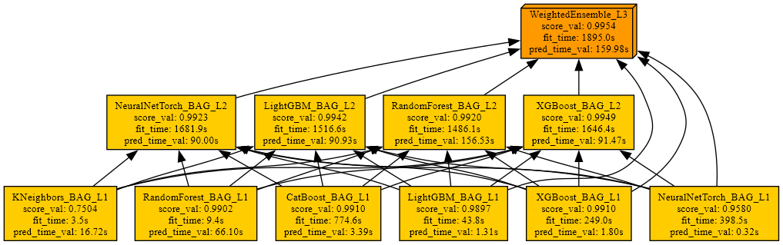
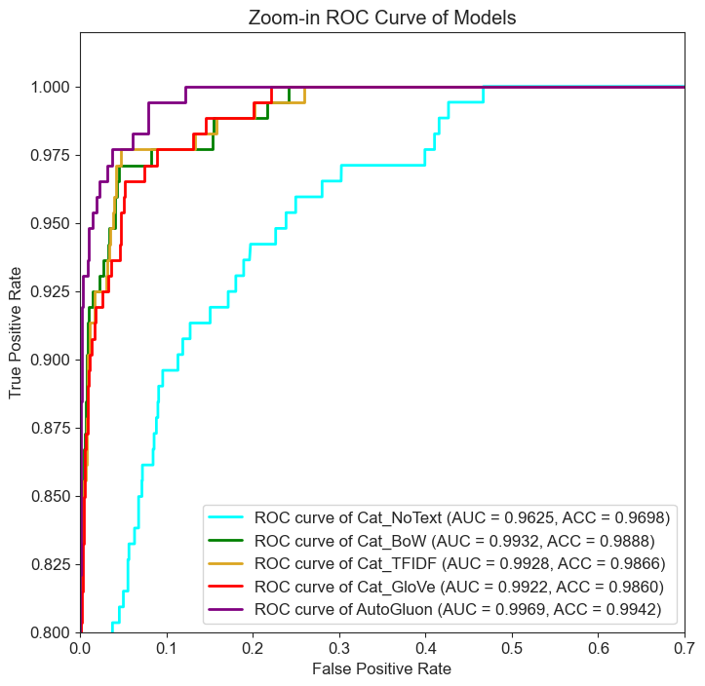
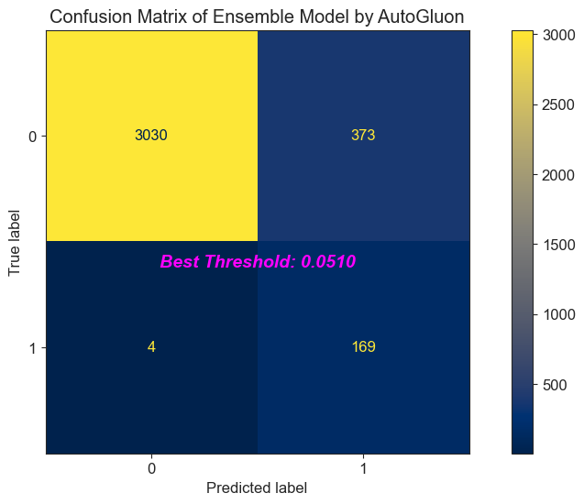
AutoGluon + text and text_n-gram
Modeling 5/5

Slide 21
Inference & Discussion

Slide 22
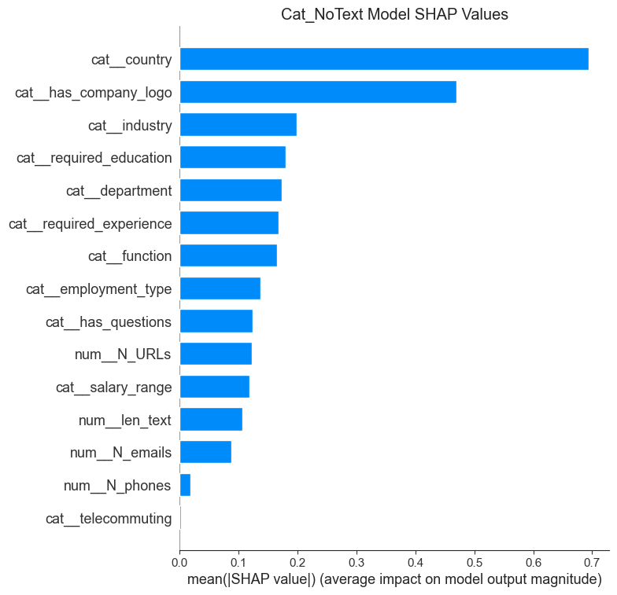
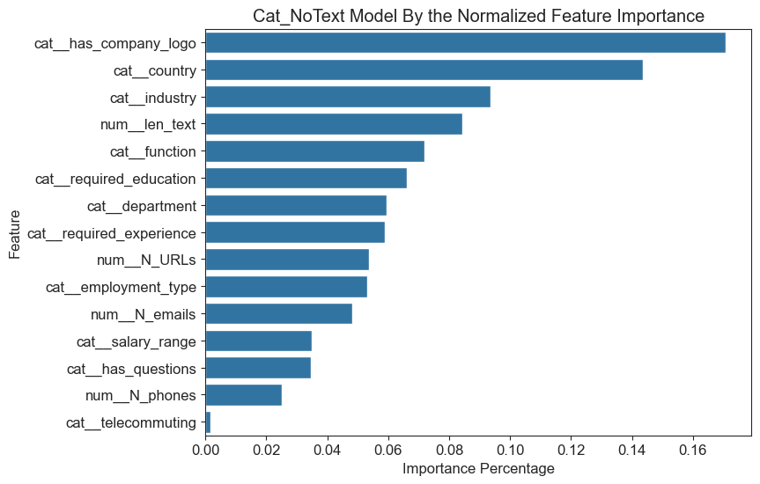
Inference of Tabular Only
Inference & Discussion 1/6

Slide 23
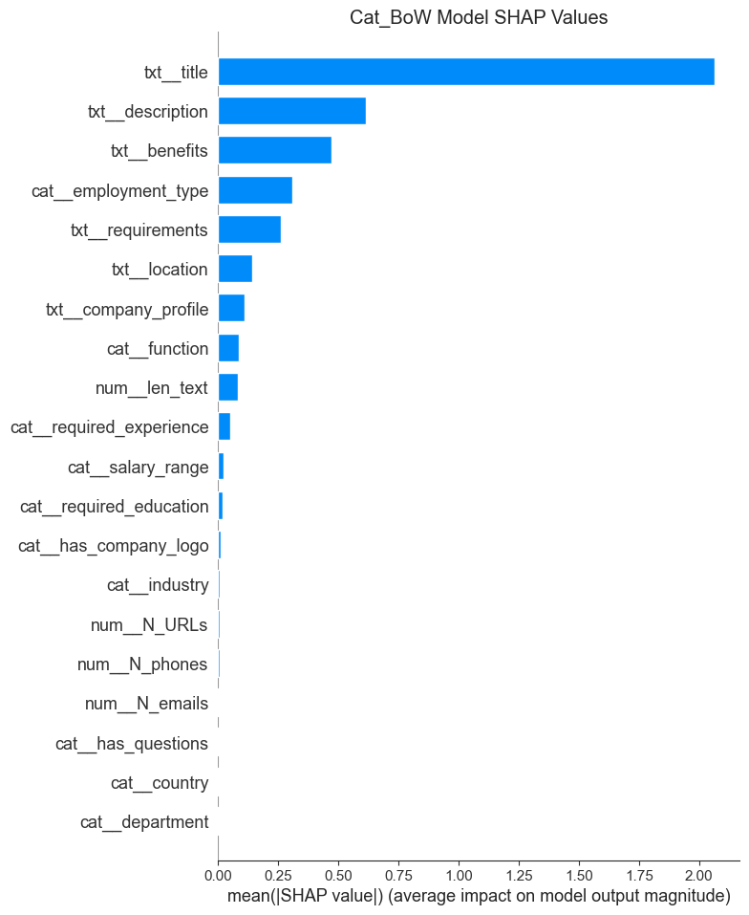
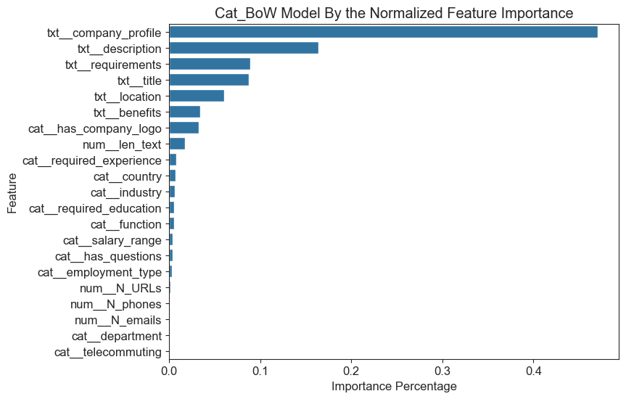
Inference of Tabular + BoW
Inference & Discussion 2/6

Slide 24
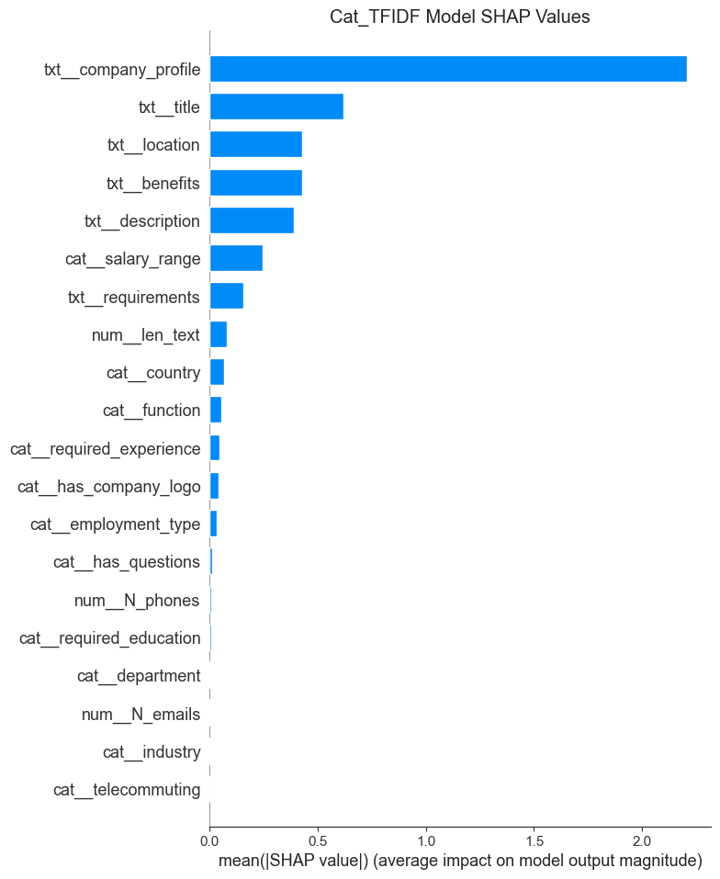
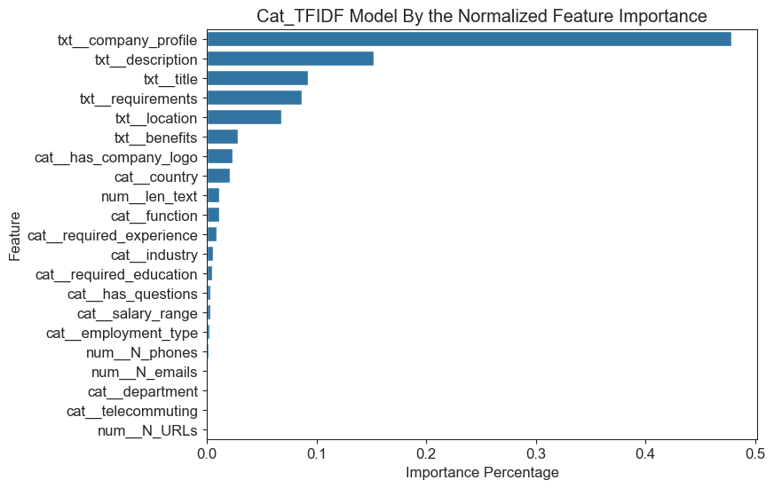
Inference of Tabular + TF-IDF
Inference & Discussion 3/6

Slide 25
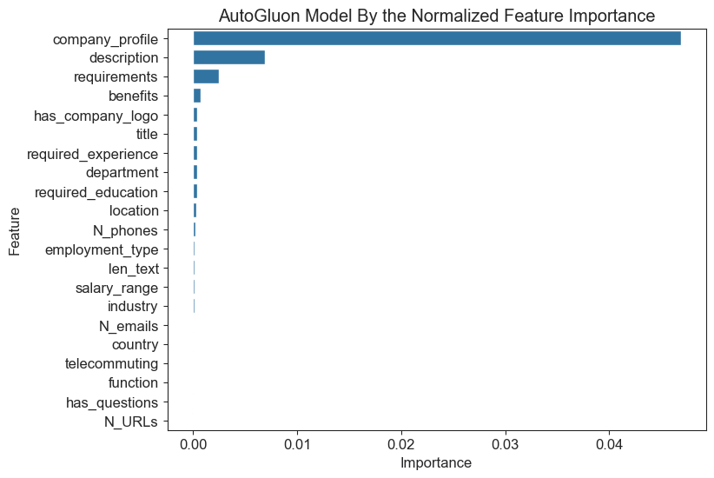
Inference of AutoGluon
Inference & Discussion 5/6

Slide 26
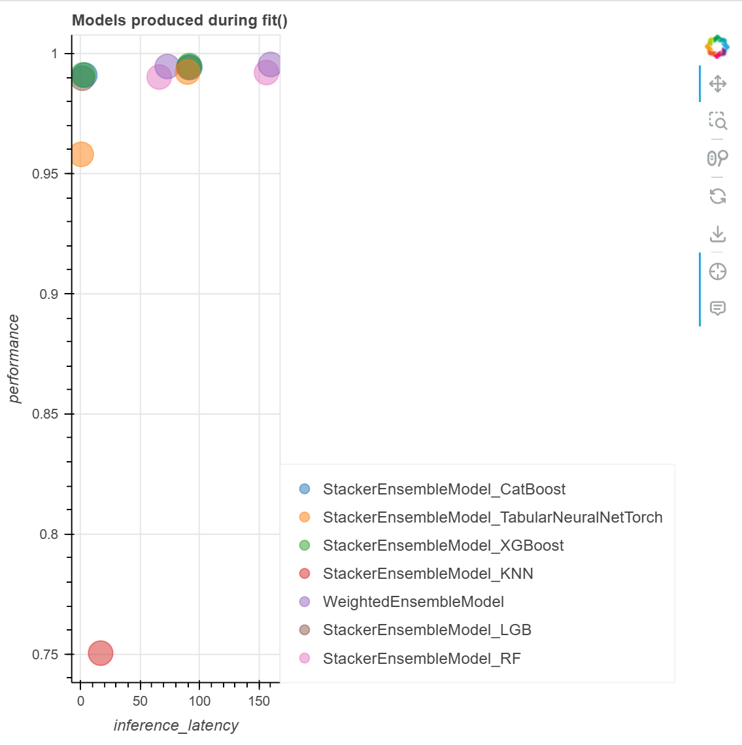
Inference of AutoGluon + text and text_n-gram
Inference & Discussion 5/6

Slide 27
Discussion
Inference & Discussion 6/6
All textual features contributes vastly to the model’s performance.
CatBoost can singlehandedly perform well even without the inclusion of the textual features.
The effort-taking curated [location] feature is the most important except the pure textual feature.
The [employment_type] comes in second by the Shapley value.
The over 75% missing containing [salary_range] contributes a lot in terms of the Shapley value.
The added numeric features, [N_URLs], [N_phones], [N_emails], [len_text] are also imperative in improving the models’ performances.
When approaching the capacity of the dataset and model, changing the embedding scheme won’t further improve the performance.

Slide 28
Acknowledgement
Established works from talented authors from Kaggle leaderboard.
Inspirations from our group members: Xinbo, Amelia, Sara, Xiaoheng, Yingxue, Daisy, and Roman.
Advice and help from our leader: Roger and Catherine.
Muchas Gracias, Muy amable!

